Slide 1
MyHealth
Patient Portal
Database
Ezequiel Romero and Adam Odell

Slide 2

Design
Introduction
MyHealth Patient Portal
Platform
LAMP Stack
phpMyAdmin
MySQL
Tools
FileZilla
Lucidchart
Repl.it
Knowledge Gap
SQL
Web Servers/Interfaces
Timeline

Slide 3
Progress
We have completed the following
ER model
phpMyAdmin Familiarity
External Programs
We will continue to work on the following
Implementing our Schema
Populating the Database
PHP Web Page Interface

Slide 4
External Programs
Using Repl.it and MySQL, we were able to develop a MySQL Database in our own environment using the CREATE TABLEs provided.
We were also able to develop a Database Generator using Python on Repl.it. This will allow us to produce our own Sample Data.
We can use these together to form a complete SQL Database, which will help us develop future SELECT statements.
https://repl.it/@EzequielRomero/Database-Systems#main.sql
https://repl.it/@EzequielRomero/Database-Generator#main.py

Slide 5



Tools
We used the following tools
Repl.it
This was used to implement an SQL Database and develop a Database Generator
Lucidcharts
This program helped us develop our ER diagram
FileZilla
We will use FileZilla to edit PHP files on the database and perform regular backups

Slide 6
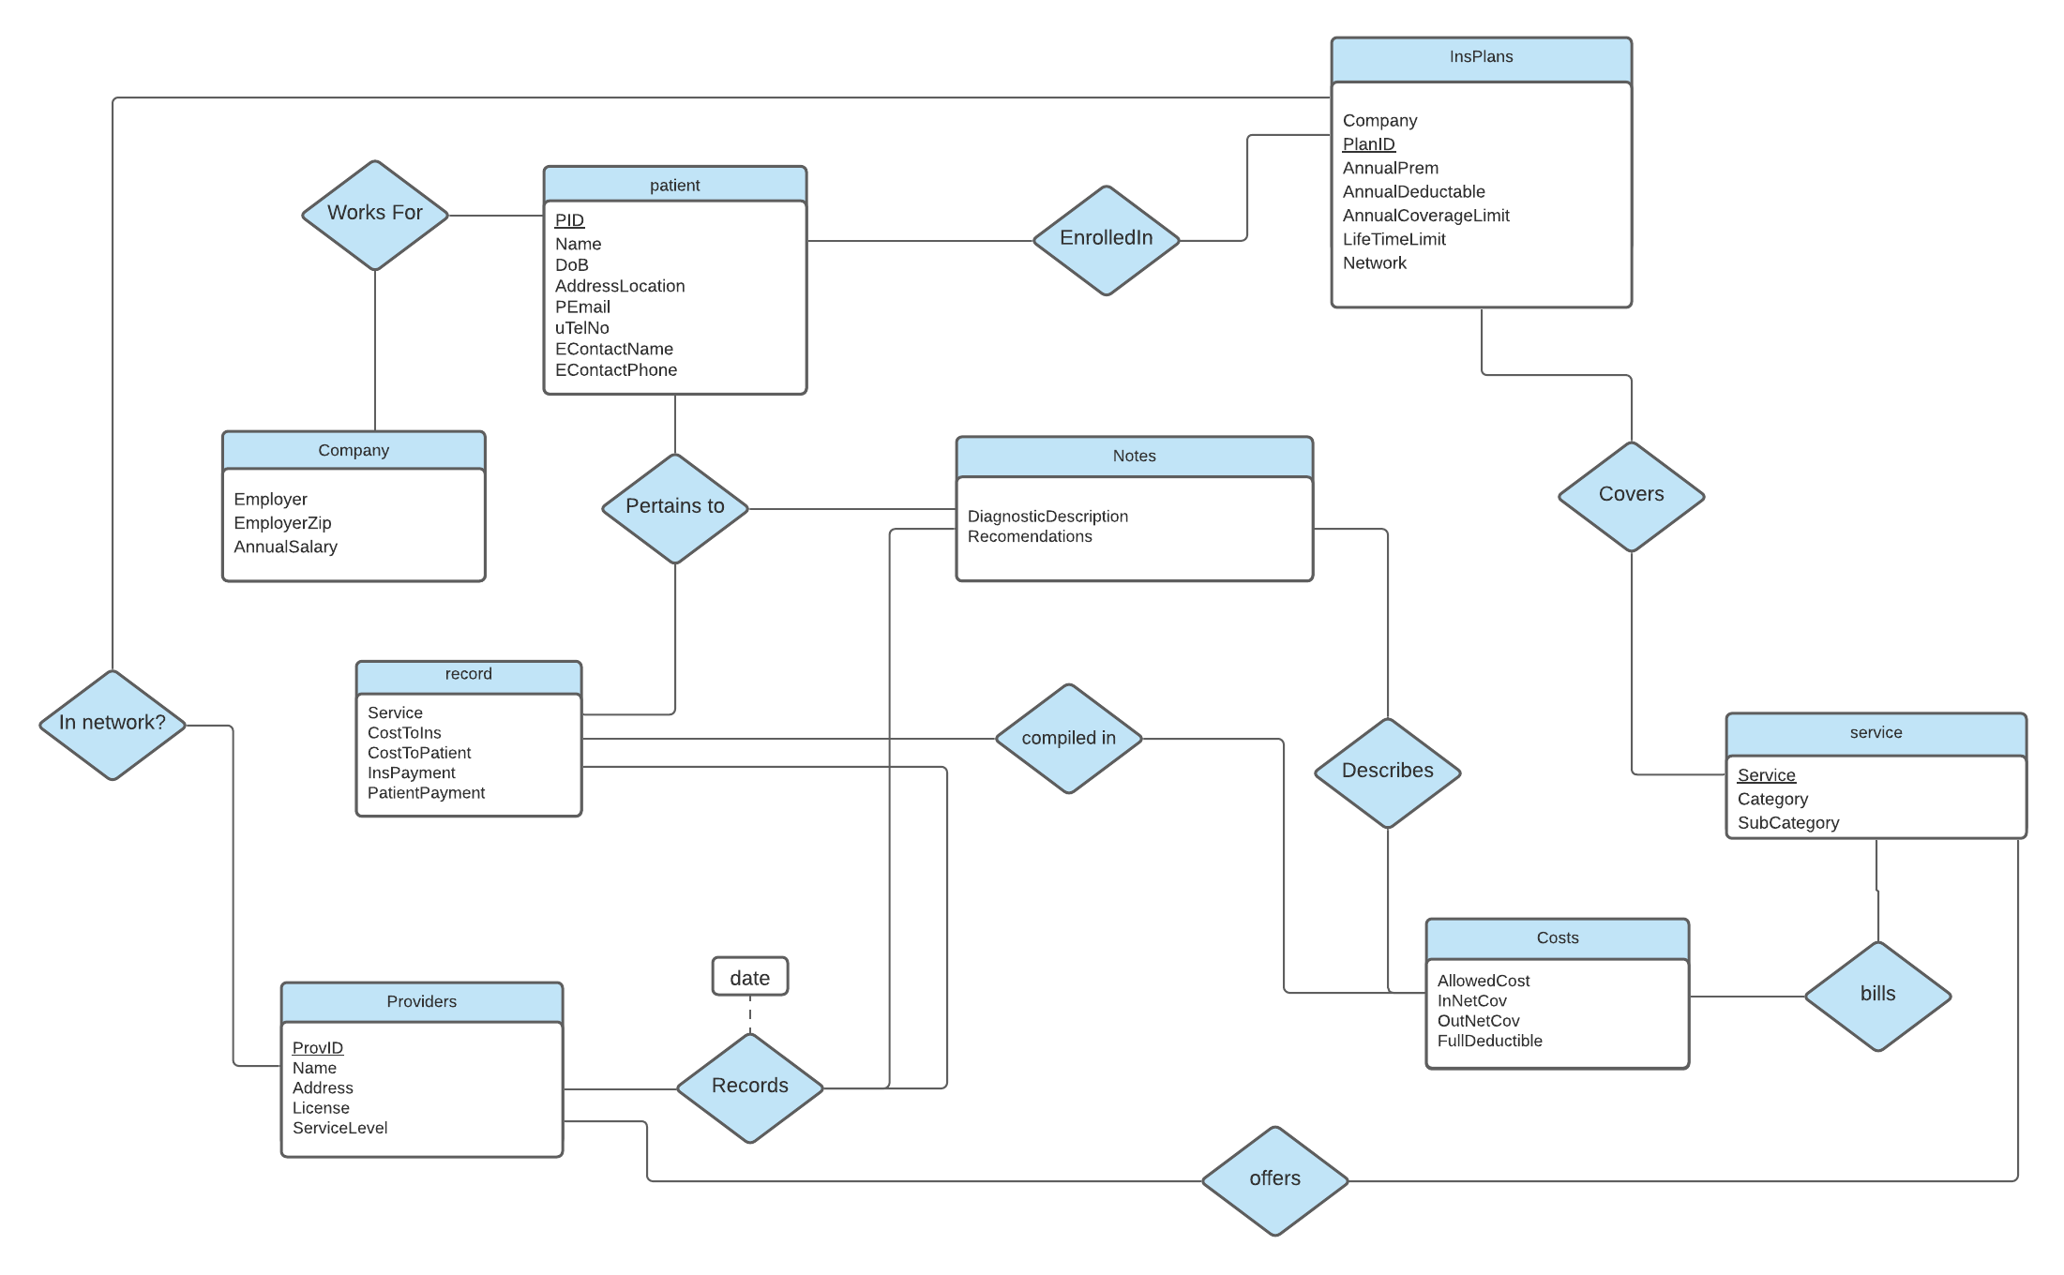
ER Diagram

